Slide 1
Python + DjanGo
Address Book Project on
Python Framework for Web Development

Slide 2

What is Django ?
Django is a Web Framework for Python Ensuring a Smooth free and uncomplicated Experience in Web Development. Django is open-source web framework that follows the model-template-views (MTV) architectural pattern. It is maintained by the Django Software Foundation, An American Based Independent organization working Over a non profit Agenda. Django was released in 2008. Latest Version of Django has been Named as Django 3.1 and was released on 4th August 2020, and the future Releases has been Planned till 5.0 which will have a support till December 2023. Django is one of the most convenient and rapid framework present in the open Market. Features Like MVT and a Lightweight Local Server make it one of the most used and preferred web development framework for developers.

Slide 3
MVT ARCHITECTURE
Model -: Used for Database Management.
View -: Used for Controlling.
Template -: Used for Templates.

Slide 4
Project Summary
Creating a new Django Project name AddressBook and a new applications inside the Project named Homepage, Further we Direct the URL To Homepage urls and render a web page from the template which has the main Address Book in the form of a HTML Table, This Table Will Have the Data which will be Rendered from the Backend. Next We add a button and set the url to ‘/addnew’, This url will render a HTML form which will take address data and save it into the database created inside Models in Homepage and migrated into SQL database. This model then will be imported, into views in Homepage and all the data will be extracted and rendered with the Homepage Address Book Table using HTML looping through Django. Finally Adding A Search Bar Below the Table for search keyword which will again filtered with the imported model in Homepage views and the result will again be rendered to the Same Table.
Notes:
m

Slide 5
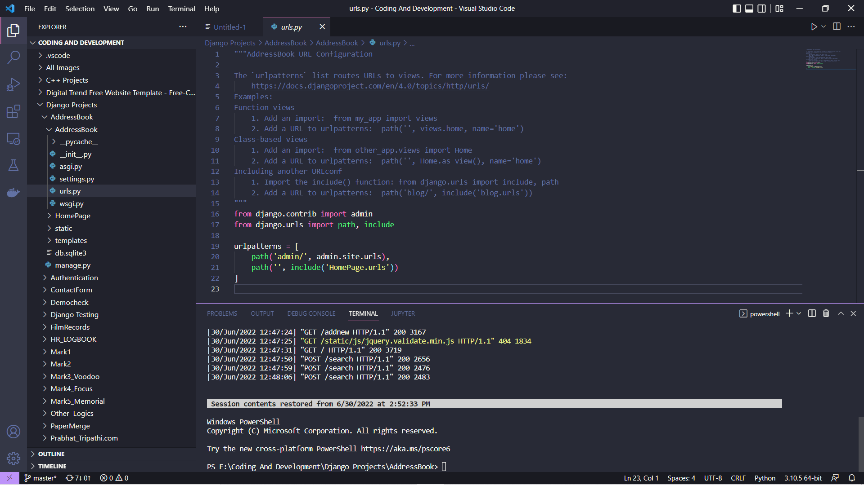
URL diversion to Homepage urls

Slide 6
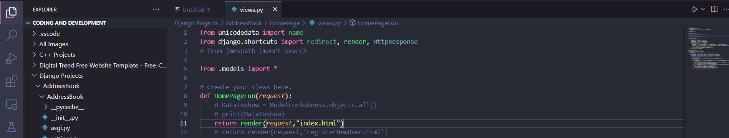
Rendering Template to URL

Slide 7
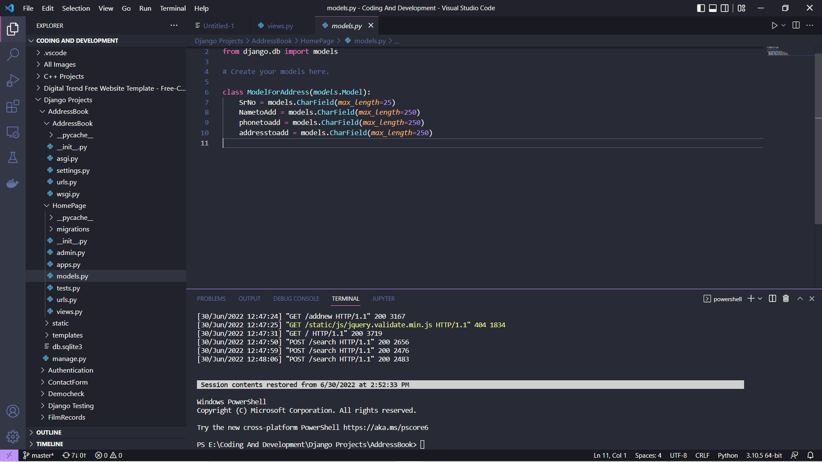
Creating Model for Saving Data

Slide 8
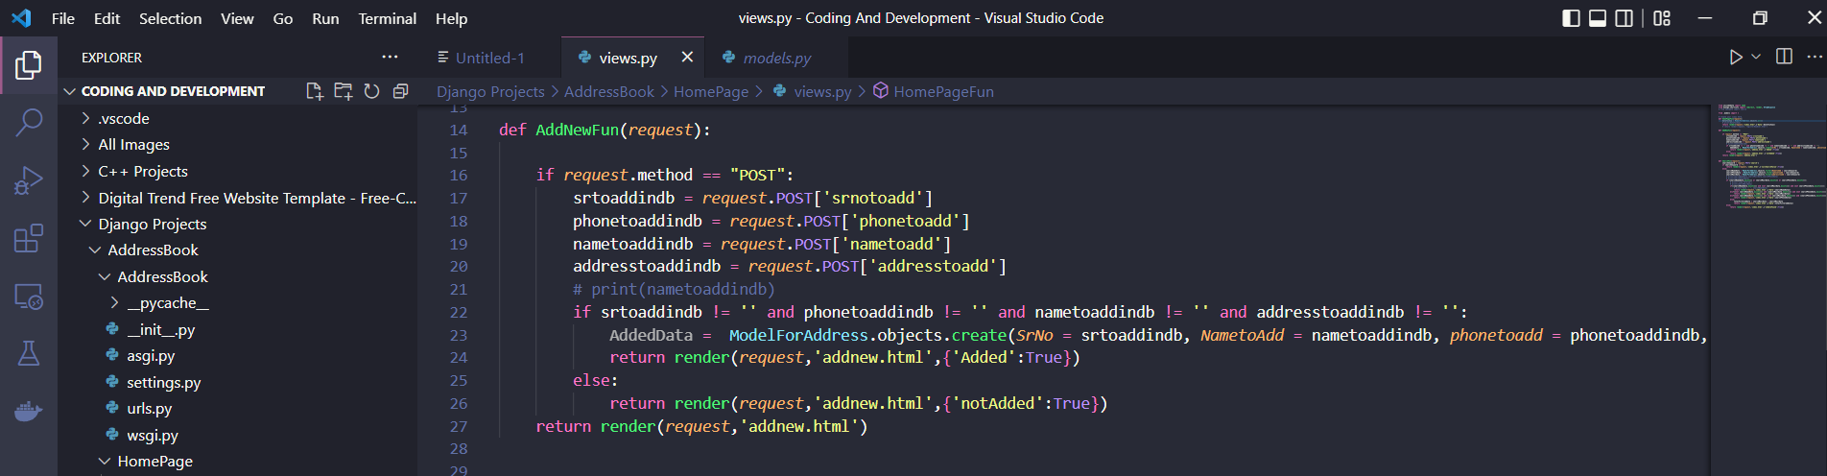
Saving Data in Database

Slide 9
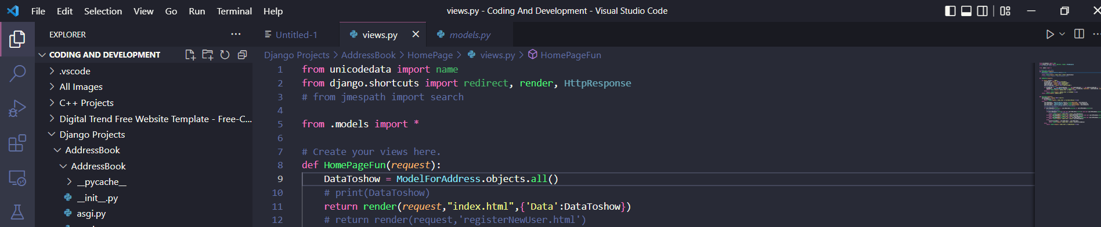
Sending Data To Template

Slide 10
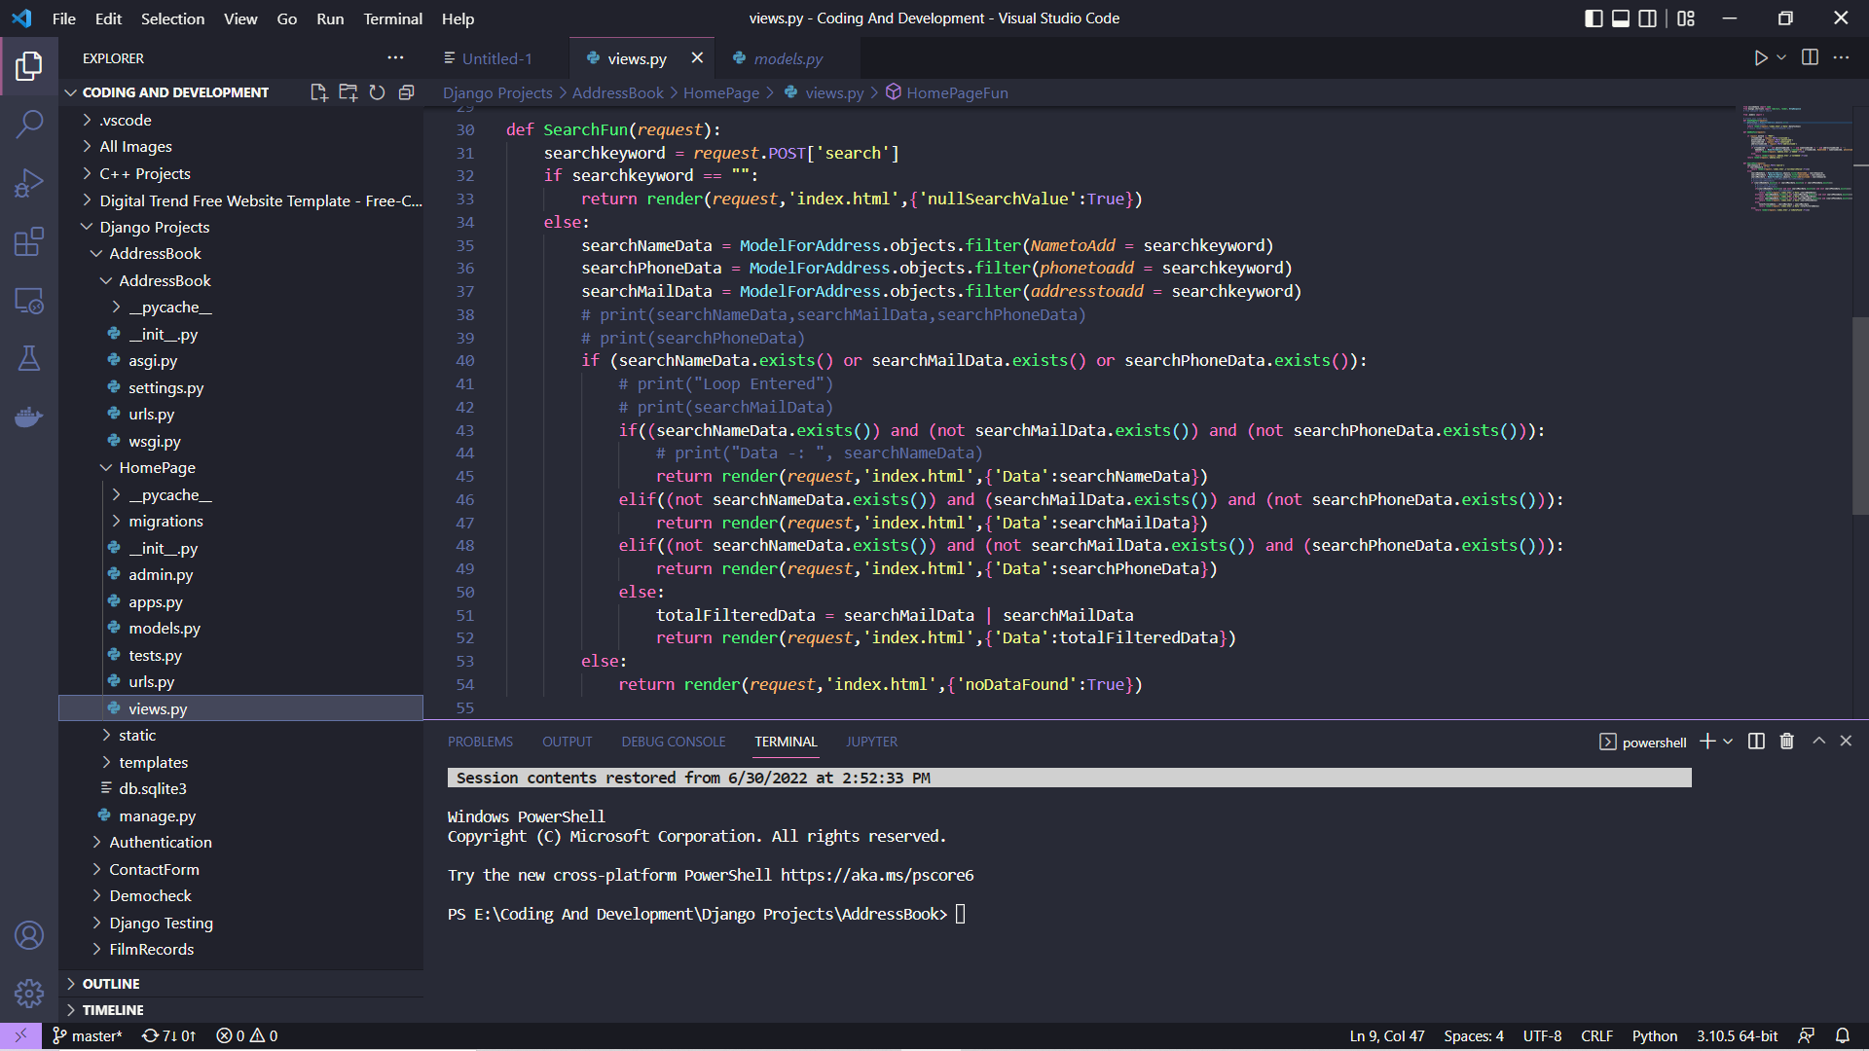
Adding Search Funtion

Slide 11
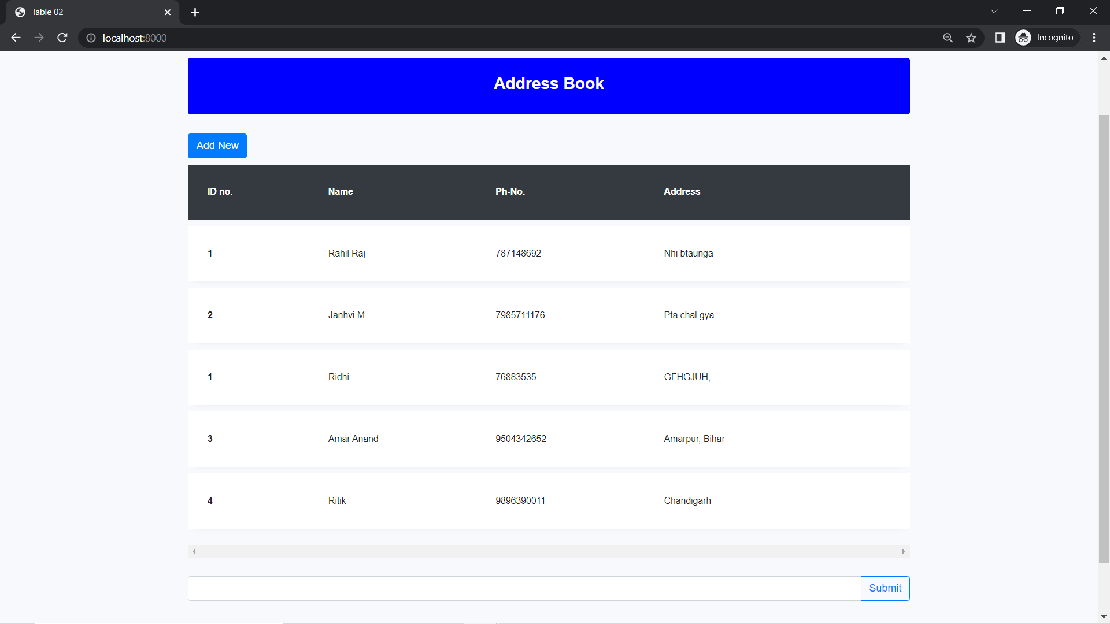
Output 1

Slide 12
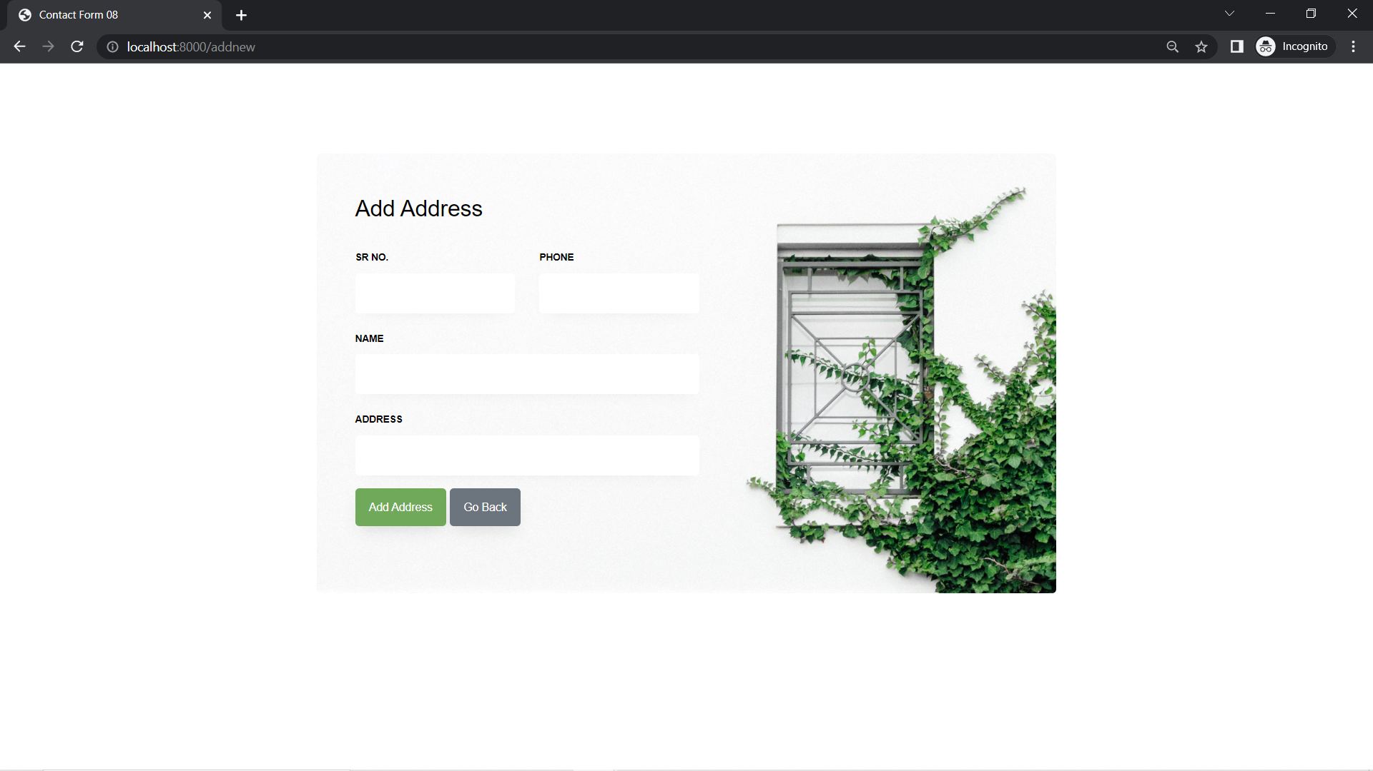
Output 2

Slide 13
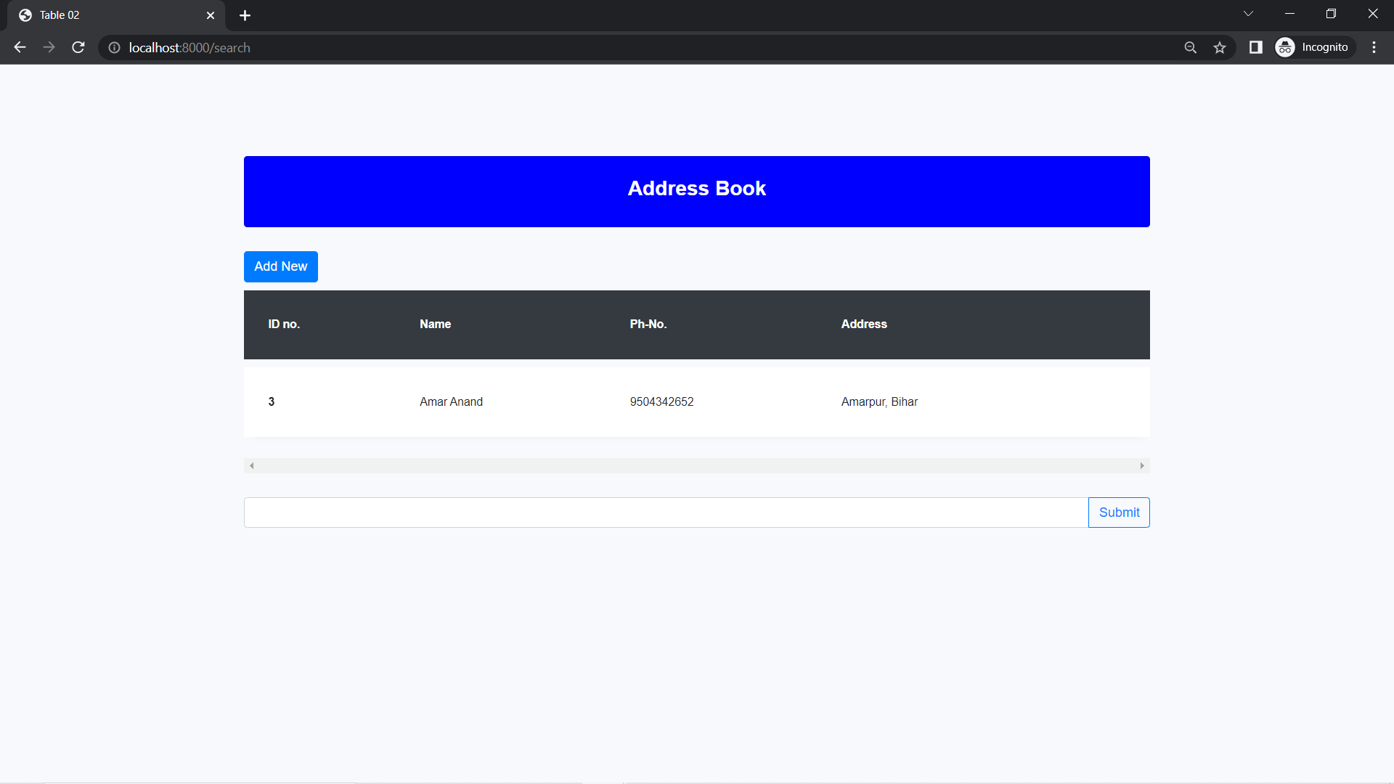
Output 3 (Search)

Slide 14
Thankyou
PRESENTED BY -:
Prabhat Tripathi
UID -: 21MCA3142

